Slide 1
System and Network Administration
Network Essentials

Slide 2
Configuring for Network Services
Networks are made of
Hosts that act as clients and servers
Servers share resources with AUTHORISED Clients
Media and Equipment that interconnect hosts
Protocols that govern connections
Users
Networks allow cooperation
Cooperation leads to communities of users

Slide 3
Network Components
Component | Description
Device | Any piece of hardware such as a computer, server, printer, or smartphone.
Media | Connects devices to the network and carries data between devices.
Network adapter | Hardware that translates data between the network and a device.
Operating system | Software that controls network traffic and access to network resources.
Protocol | Software that controls network communications using a set of rules.

Slide 4




Slide 5
ISO OSI Reference Model
Understanding the abstract architecture is key to understanding the concrete network
The ISO Seven “layer” OSI Model is a Conceptual model that describes many types of network.
The Internet is a fairly unsophisticated example.
Each layer represents a higher level of abstraction in the process of data communications
Complexities of low level transmission of signals representing the data are hidden from users at the application level (top layer)

Slide 6
OSI Model: Information Flow
7. Application
Provides network services to user applications
7. Application
6. Presentation
Coding and conversion to ensure both ends use a common data format
6. Presentation
Establish, maintain, & terminate the “conversation” between endpoint processes
5. Session
“Please Do Not Throw Snow Peas Away”
5. Session
4. Transport
Process ID, Error detection, Flow control
4. Transport
3. Network
Network Addressing & Routing
3. Network
2. Data-Link
Interface Address, Error detection, Flow control
2. Data-Link
1. Physical
Voltage levels, Maximum transmission distances, Physical connectors
1. Physical

Slide 7
OSI
TCP/IP
Understanding the abstract architecture is key to understanding the concrete network
7. Application
5. Application
For this class the concrete network is TCP/IP over Ethernet
6. Presentation
5. Session
4. Transport
Secure Sockets Layer (SSL)
4. Transport
TCP: Handshake, Port, Sequence
IP: Source & Destination Address, Subnets, Routing
3. Network
3. Internet
2. Network
Access
Ethernet: CSMA/CD - Broadcast
2. Data-Link
Link Layer Control (LLC)
Media Access Control (MAC) Address
1. Physical
1. Physical

Slide 9
Packets and Encapsulation
Packets: Header and payload
Header tells where the packet came from and where it’s going
Payload is the data
TCP layer it’s called a segment
IP layer it’s called a packet
Link layer it’s called a frame
Cultural
Sensitivity

Slide 10
Encapsulation
A packet is a structured message.
The control information of a given protocol must be treated strictly as data by the next "lower" protocol.
As a packet moves down the protocol stack, it gets bigger as information relevant to the layer is added to the beginning and the end.
Any given layer is allowed to work only with the data relevant to that layer, and nobody else's.
As a packet moves up the stack it gets smaller, as the information from the current level is removed.

Slide 11
Ethernet, IP, and TCP
TCP Segment
Header
Data
IP Datagram Header
Complete TCP Segment
Treated as Data
Frame Header
Complete IP Datagram
Treated as Data
CRC
Remember, this is really just a stream of bits
0011110101010101110000101010101010001010110101001001010100101110010100

Slide 12
Ethernet Frame Format
Key Fields
Preamble: Alternating 1's and 0's to help receiving nodes synchronise
Address: Unique identifier assigned by the hardware manufacturer (MAC Address)
Packet Type: identifies this as an Ethernet frame (allows mutiple protocols and versions)
CRC: Error detection (Cyclic Redundancy Check)
Preamble (64 bits)
Destination Address (48 bits)
Source Address (48 bits)
Packet type (16 bits)
Data (368-12,000 bits)
CRC (32 bits)
Remember, this is really just a stream of bits
0011110101010101110000101010101010001010110101001001010100101110010100

Slide 13
Datagram Format Each row represents 4 octets (32 bits)
Key Fields
IP is version 4 or 6
QOS requests priority
Second Row controls Fragmentation (e.g., "2 of 4")
Gateways decrement TTL and discard the datagram if zero
Protocol is analogous to Ethernet Type, Header Checksum to CRC
Options are included for network testing (not required)
Version - Length - QOS - Total Length
Unique ID - Flags - Fragment Offset
Time to Live - Protocol - Checksum
Source IP Address
Destination IP Address
Options - Padding
Data (up to 4416 bits)
Remember, this is really just a stream of bits
0011110101010101110000101010101010001010110101001001010100101110010100

Slide 14
TCP Segment Format Each row represents 4 octets (32 bits)
Key Fields
Port number specifies service
Sequence is position in sender's byte stream
Acknowledgement of position in sender's byte stream
Some segments carry only ACK, others carry data, and others a request to establish or close a connection (Code)
Window and Options negotiate maximum segment size
Source Port - Destination Port
Sequence Number
Acknowledgement Number
Offset - Code - Window
Checksum - Urgent
Options - Padding
Data (up to 4224 bits)
Remember, this is really just a stream of bits
0011110101010101110000101010101010001010110101001001010100101110010100

Slide 15
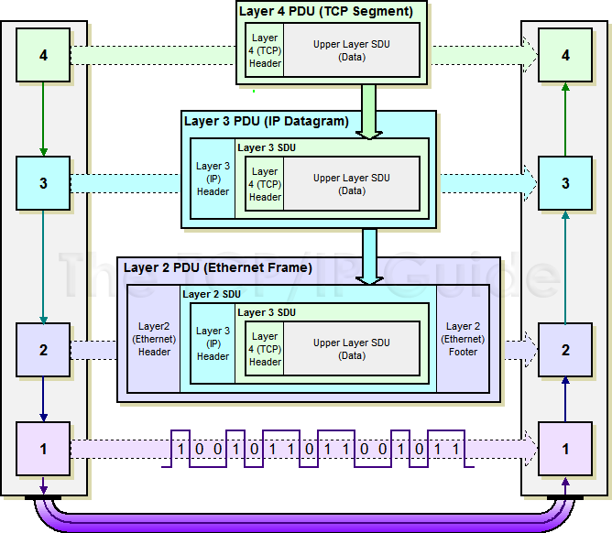

Slide 16
Ethernet, IP, and TCP
Is there a service on this port? Yes: Pass up the DATA part No: discard it
TCP Segment
Header
Data
Is this my IP address? Yes: Pass up the DATA part No: discard it
Am I a Router? Yes: Pass the whole packet to all interfaces No: ~
IP Datagram Header
Complete TCP Segment
Treated as Data
Is this my MAC address? Yes: Pass up the DATA part No: discard it
Frame Header
Complete IP Datagram
Treated as Data
CRC
Is this an ethernet frame? Yes: Pass it up No: discard it
Data Link Layer: stream of bits
0011110101010101110000101010101010001010110101001001010100101110010100

Slide 18
Beyond a broadcast domain, communication is typically through a network of intermediate switching nodes.
Switching is the process of taking an incoming frame from one interface and delivering it out through another interface.
At Layer 2 frames are switched based on MAC address
At Layer 3 packets are switched based on IP address
Host A
Host B
HTTP | Identical Message (end-to-end) |  |  |  | HTTP
TCP | Identical Segments (end-to-end) |  |  |  | TCP
IP | Identical Datagram | Intermediate Router (Layer 3) or Switch (Layer 2) |  | Identical Datagram | IP
Ethernet | Proper Frame |  |  | Proper Frame | Ethernet
Network Interface | Wiring | Network Interface | Network Interface | Wiring | Network Interface

Slide 19
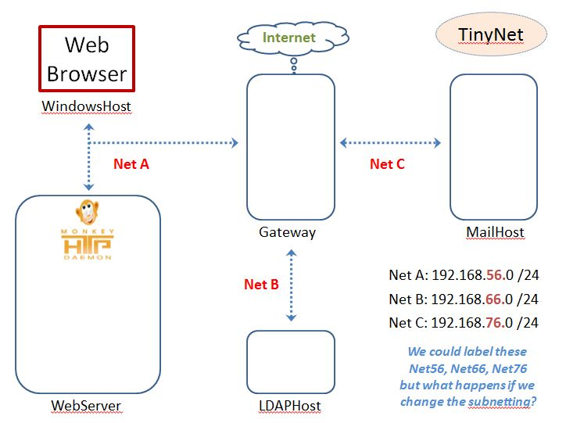
TinyNet in practice

Slide 20
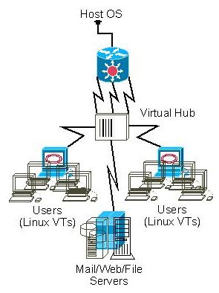
Virtual Networking
VirtualBox provides Layer 2 (Network Access) interconnection
A hub broadcasts every message to every interface
We can watch this with a packet sniffer when we put the interface into promiscuous mode
TinyNet
Layer 2

Slide 21
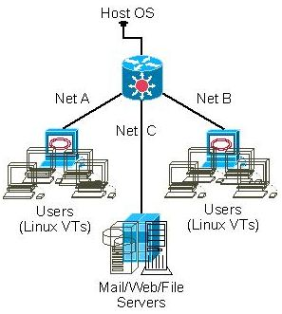
Virtual Networking
Layer 3 (Internet) interconnection is more useful
Assign an IP address to each interface
Configure a default or static route to the gateway
Gateway interconnects subnets
TinyNet
Layer 3

Slide 22
Addresses
Layer 2 addresses are put into the interface ROM by the hardware manufacturer
Layer 3 addresses are assigned by the network administrator
If users move to another building (or WAP), their device may get a new Layer 3 address, but the Layer 2 address remains the same.
The broadcast domain is everyone who can hear a broadcast.
It is important to limit the size of the broadcast domain because too many broadcast frames can overwhelm endpoints, switches and routers
At layer 3 the broadcast domain is defined by the subnet mask.
At layer 2 a hub is a single broadcast domain, or switch ports are configured to define the broadcast domain (vlan tagging).

Slide 23

IP Addressing & Subnet Masks
Subnet Mask is like an IPv4 Address: 32 bits long
Specifies which part of an IP address is the network/subnet field and which part is the host field
The prefix portion of the mask is all 1s in binary.
The host portion of the mask is all 0s in binary.

Slide 24
Classless Addressing (VLSM)
Extend the network prefix by borrowing bits from host address range
a Variable Length Subnet Mask (VLSM)
An IP address is accompanied by an indication of the prefix length
192.168.11.0 255.255.255.0
Convert the binary expression to dotted-decimal notation
192.168.11.0/24
/ specifies the number of ones “up front”
Contiguous subnet mask: no 1 bit appears to the right of any 0 bit

Slide 25
This network has 3 subnets
The routing table actually has both the IP address and the netmask
You cannot tell what subnet an address belongs to without knowing the netmask!
172.16.30.1
172.16.30.2
172.16.30.0
Beta
172.16.20.0
172.16.40.0
Network | Netmask
172.16.20.0 | 255.255.255.0
172.16.30.0 | 255.255.255.0
172.16.40.0 | 255.255.255.0
Alpha
Iota
172.16.20.2
Delta
172.16.40.2
172.16.20.1
172.16.40.1

Slide 26
Virtual Local Area Networks (VLANs)
A logical method of segmenting a network at the data link layer (layer 2) – Also called VLAN Tagging.
Similar to subnets.
However, subnets are network layer (layer 3).
VLANs enable grouping of network hosts not on the same physical switch or multiple VLANs on the same physical switch.
If network configuration changes, the physical cabling and devices don't need to.
VLANs can be configured with one or more subnets.

Slide 28
Internet Protocols and Standards
Application
/etc/services
IANA: Internet Assigned Numbers Authority
Transport
TCP
UDP
IETF: Internet Engineering Task Force
Internet
ICMP
IP
RFC: Request For Comments
Network
Access
ARP
Ethernet
IEEE: Institute of Electrical and Electronic Engineers
And Others
ITU: International Telecommunications Union

Slide 29
ARP - Address Resolution Protocol
Concerned with mapping layer 2 to layer 3 addresss, e.g., MAC address to IP address.
The source host sends an ARP request by broadcast, asking “who has IP address A.B.C.D?”
If the destination host (which owns A.B.C.D) sees the ARP query, it responds and sends its MAC address.
If the destination host is not on the same local network, the router/gateway will respond and send its own MAC address.
The source host registers the MAC address obtained and a data-link (layer 2) connection is established between the two hosts.
Notes:
Network Admin - Internet Services
12-Aug-20
29

Slide 30



ARP - Address Resolution Protocol
arp Request
ARP Spoofing relies on the decentralized, unauthenticated, and completely trusting nature of ARP
Source IP: 192.168.6.1
Source MAC: a1:b2:c3:d4:e5:f6
Target IP: 192.168.6.101
Target MAC: 00:00:00:00:00:00
arp Reply
Any reply is cached, even if no request was sent. Attackers can easily substitute their MAC and divert traffic.
Source IP: 192.168.6.101
Source MAC: 1a:2b:3c:4d:5e:6f
Target IP: 192.168.6.1
Target MAC: a1:b2:c3:d4:e5:f6

Slide 31
ICMP - Internet Control Message Protocol
Used for gateway management:
congestion control (source quench)
route-change notification (redirect)
subnet addressing (address mask request/reply)
Also for general network management:
reachability testing (echo request/reply)
performance measuring (timestamp)
Notes:
Network Admin - Internet Services
12-Aug-20
31

Slide 32


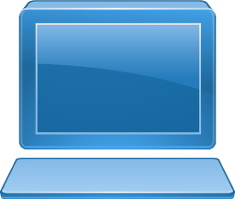
ping
Uses ICMP “echo request” and “echo reply” to check network connectivity.
Used to check a target host for a response.
Many systems block ICMP to prevent attacks:
Flood system in a Smurf attack.
Reconfigure routing tables with forged packets.
Is 192.168.0.154 reachable?
192.168.0.154
1
Echo request
2
Echo reply

Slide 33
UDP - User Datagram Protocol
Connectionless service for application level procedures
Unreliable: delivery not guaranteed & no duplication control
Reduced overhead, least common denominator service
Used when one IP packet is sufficient for the whole message
DNS tries to use UDP first, fallback to TCP
Notes:
33
In addition to TCP, there is one other transport-level protocol that is in common use as part of the TCP/IP protocol suite: the user datagram protocol (UDP), specified in RFC 768. UDP provides a connectionless service for application-level procedures. UDP is basically an unreliable service; delivery and duplicate protection are not guaranteed. However, this does reduce the overhead of the protocol and may be adequate in many cases. A connectionless service is more appropriate in some contexts. It represents a "least common denominator" of service to be expected at higher layers. Some examples:
• Inward data collection: the periodic active or passive sampling of data sources, such as sensors, and automatic self-test reports from security equipment or network components.
• Outward data dissemination: Includes broadcast messages to network users, the announcement of a new node or the change of address of a service, and the distribution of real-time clock values.
• Request-response: in which a transaction service is provided by a common server to a number of distributed TS users, and for which a single request-response sequence is typical. Use of the service is regulated at the application level, and lower-level connections are often unnecessary and cumbersome.
• Real-time applications: Such as voice and telemetry, involving a degree of redundancy and/or a real-time transmission requirement. These must not have connection-oriented functions such as retransmission.
Network Admin - Internet Services

Slide 34
TCP: Transmission Control Protocol
TCP connections provide reliable delivery for messages that are too big for a single packet
The message is broken into a number of packets before it is sent
Packets can arrive in any order, missing packets are re-sent
Packet sequence numbers are established during the initial connection using a “3-Way Handshake”.
Other initial connection setup messages establish parameters of channel e.g., buffer sizes, error detection & recovery procedures.
Notes:
FIT2018 Network Admin: Principles of Security
12/08/2020
FIT2018 (c) Monash University
34

Slide 35
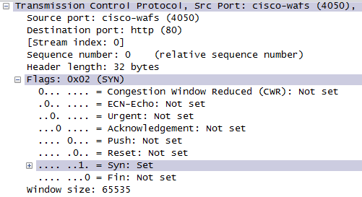
Background: TCP
The TCP segment (packet) header has six flag bits that can be set independently.
to remember them in order
Unskilled Attackers Pester Real Security Folks.
http://www.lovemytool.com/blog/2010/07/practical-tcp-series-tcp-flags-by-chris-greer.html

Slide 36
Background: TCP
Four flag bits can be set to describe the state of the connection:
SYN (SYNchronise) is used for starting a connection
ACK (ACKnowledge) is used to confirm packets are received
FIN (FINish) is used for ending a connection
RST (ReSeT) is used to denote no service on the port (closed)
PSH (PuSH) and URG (URGent) are used to ensure priority over other packets for processing when a packet is received.
The CWR and ECN bits may be used together by a client and server that can use RFC 3168 Explicit Congestion Notification.

Slide 37
Background: TCP
The initial connection with a TCP service is established with the "TCP 3 way handshake".
First a SYN is sent to a port that has a service bound to it (an open port). Typical examples are HTTP (port 80), SMTP (port 25), or SSH (port 22).
The server side will see the SYN and respond with SYN + ACK, with the client answering with an ACK. This completes the set up and the data of the service protocol can now be communicated.
After this, an ACK is sent after receiving each "window size" group of packets (details are beyond our scope, we have nice graphic).
When a host sends a FIN to close a connection, it may continue to receive data until the remote host has also closed the connection, although this only occurs under certain circumstances.

Slide 38
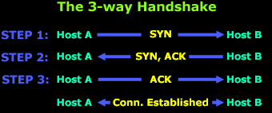
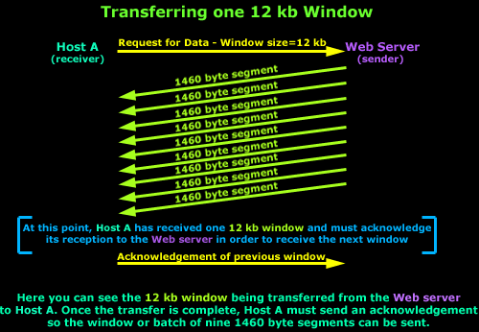
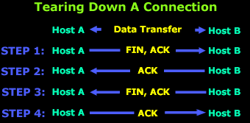
Background: TCP
http://www.firewall.cx/networking-topics/protocols/tcp/136-tcp-flag-options.html
http://www.firewall.cx/networking-topics/protocols/tcp/137-tcp-window-size-checksum.html

Slide 40
Ports and Port Ranges
Port: The endpoint of a logical network connection.
Client computers connect to server programs through a designated port.
Port is a “Layer 4” concept – TCP header
All ports assigned are between the numbers 0 and 65535.
Port | Service | Secure | Port
20 | Telnet | SSH | 22
25 | SMTP | SMTPS | 465
80 | HTTP | HTTPS | 443
143 | IMAP | IMAPS | 993
389 | LDAP | LDAPS | 636
Port | Service
53 | DNS
67 | DHCP (server)
68 | DHCP (client)
587 | Submission

Slide 41
Service names and port numbers
Service names and port numbers are used to distinguish between different services that run over TCP and UDP (transport layer)
A port is actually just a 16 bit number used as an identifier
The registration procedures for service names and port numbers are described in [RFC6335].
Service names are assigned by IANA with a first-come, first-served process.

Slide 42
Transport Protocol Addresses: TCP & UDP Port Numbers
/etc/services
# This file contains port numbers for well-known services defined by IANA
# Format:
# <service name> <port number>/<protocol> [aliases...] [#<comment>]
discard 9/tcp sink null
discard 9/udp sink null
qotd 17/tcp quote #Quote of the day
qotd 17/udp quote #Quote of the day
ftp-data 20/tcp #FTP, data
ftp 21/tcp #FTP. control
telnet 23/tcp
smtp 25/tcp mail #Simple Mail Transfer Protocol
time 37/tcp timserver
time 37/udp timserver
domain 53/tcp #Domain Name Server
domain 53/udp #Domain Name Server
bootps 67/udp dhcps #Bootstrap Protocol Server
bootpc 68/udp dhcpc #Bootstrap Protocol Client
tftp 69/udp #Trivial File Transfer
finger 79/tcp
http 80/tcp www www-http #World Wide Web
Notes:
Look for /etc/services on Unix systems and C:\windows\system32\drivers\etc\services on Windows.
Network Admin - Internet Services
12-Aug-20
42

Slide 43
Port numbers are assigned based on three ranges:
The Well Known or System Ports (0-1023)
Ports under 1024 restricted to root
The Registered or User Ports (1024-49151),
The Dynamic and/or Private Ports (49152-65535);
System Ports are assigned by IETF for standards-track protocols, User Ports are assigned by IANA, and dynamic ports are not assigned.

Slide 45
netstat – Network Statistics
netstat –a (connections)
netstat –i (interfaces)
netstat –nr (routing)
netstat –tulp (tcp+udp listening ports)
Consulting the man pages for lsof and netstat is highly recommended.
These tools are flexible and can provide a wealth of information about network services and configuration.

Slide 46
Finding Listening Sockets
If you want to know what process has a connection open to or from the Internet host aaa.bbb.ccc
lsof -i@aaa.bbb.ccc
You can add in a particular protocol and a specific port number or service name
lsof -iTCP@aaa.bbb.ccc:http

Slide 47
Listing Open Files
If you're interested in knowing what files the processes owned by a particular login name have open
lsof -u<login> or lsof -u<User ID number>
Run this on an NFS client to list all files open by processes on the client that are on remote NFS file systems
lsof -N
Note that lsof can only examine the processes running on the machine where it is called, so if this is run on the server it will not list files opened by clients.

Slide 49
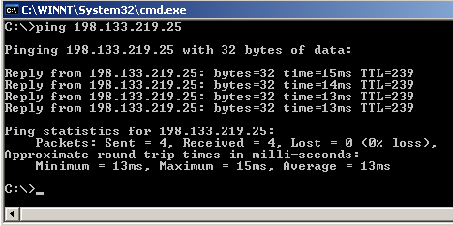
Test connectivity with Ping
With the loopback address (127.0.0.1) to verify that TCP/IP is correctly installed and bound to your network adapter card.
With the local IP address to verify that another computer on the network does not have the same one.
With the IP address of the default gateway to verify that it is operational and able to communicate with the local network.
With the IP address of a remote host to verify that the computer can communicate through the gateway.
oops ... command line, no GUI

Slide 50
Work the layers
Interface properly configured?
Ping localhost 127.0.0.1?
Ping other hosts on the same subnet by IP address?
Ping the gateway?
Ping other local hosts by name?
Ping hosts on another network?
Do telnet and ssh work?

